Slide 1
Reverse Time Migration of Multiples for OBS Data
Dongliang Zhang
KAUST

Slide 2
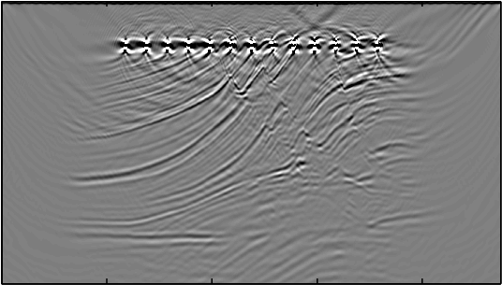
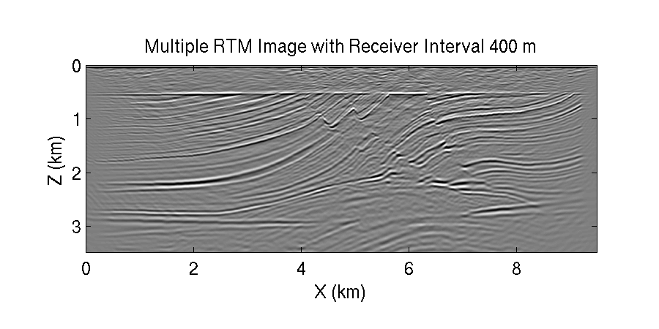
Outline
Motivation
Wider illumination, no footprint artifacts
Theory
Reverse time migration of multiples
Numerical Example
Test on Marmousi model and field data
Conclusions

Slide 3
Outline
Motivation
Wider illumination, no footprint artifacts
Theory
Reverse time migration of multiples
Numerical Example
Test on Marmousi model and field data
Conclusions

Slide 4
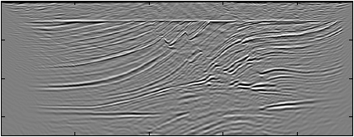
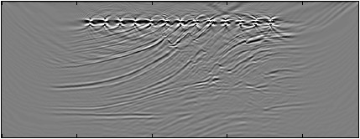
Motivation
No footprint artifacts Wider illumination
reciprocity
Migration Image of Multiples
Migration Image of Primary

Slide 5
Outline
Motivation
Wider illumination, no footprint artifacts
Theory
Reverse time migration of multiples
Numerical Example
Test on Marmousi model and field data
Conclusions

Slide 6
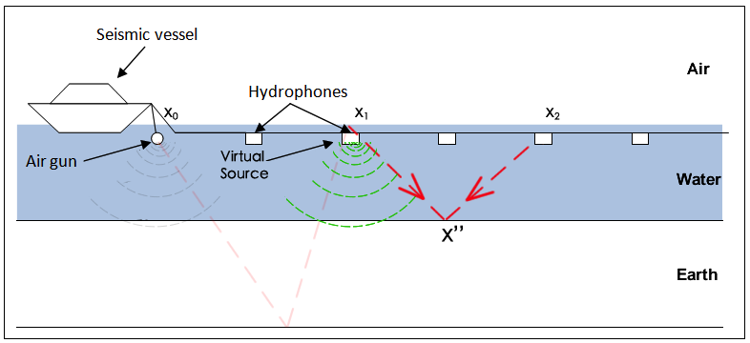
Primary RTM of Streamer Data
Primary
Multiple
time

Slide 7
Multiples RTM of Streamer Data
Primary
Multiple
time
Multiples
Receiver Source | 1st- order multiple | 2nd- order multiple | ……
primary | image | artifact | artifact
1st- order multiple | artifact | image | artifact
2nd- order multiple | artifact | artifact | image
……
Data

Slide 8
Multiples RTM of Streamer Data
Primary
Multiple
time
Receiver Source | primary | 1st- order multiple | 2nd- order multiple | ……
primary | artifact | image | artifact | artifact
1st- order multiple | artifact | artifact | image | artifact
2nd- order multiple | artifact | artifact | artifact | image
……
Data
Data

Slide 9
Multiples RTM of OBS Data
Up-going wave
Down-going wave
Combine up-going & down-going waves

Slide 10
Multiples RTM of OBS Data
Up-going wave
Down-going wave
Combine up-going & down-going waves

Slide 11
Up-going Wave
reciprocity

Slide 12
Multiples RTM of OBS Data
Up-going wave
Down-going wave
Combine up-going & down-going waves

Slide 13
Down-going Wave
reciprocity

Slide 14
Multiples RTM of OBS Data
Up-going wave
Down-going wave
Combine up-going & down-going waves
Don’t need to separate up-going and down-going wave
Same procedure as up-going and down-going wave

Slide 15
Illumination: Primary vs Multiples
Illumination of Primary for One Shot
Illumination of Multiples for One Shot

Slide 16
Footprint Artifact
Sparse Receivers (Sources)
Image of Primary
Image of Multiples

Slide 17
Outline
Motivation
Wider illumination, no footprint artifacts
Theory
Reverse time migration of multiples
Numerical Example
Test on Marmousi model and field data
Conclusions

Slide 18
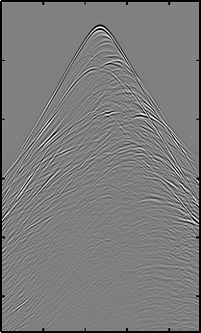
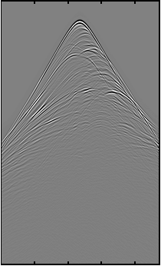
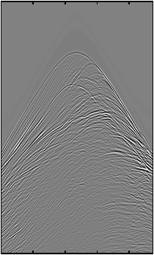
Marmousi Model
True Velocity Model
1.5 km/s 5.5
3.5 Z (km) 0
Full Data
Direct Wave & Primary
Multiples
6 T (s) 0
0 X (km) 9
0 X (km) 9
0 X (km) 9
0 X (km) 9

Slide 19
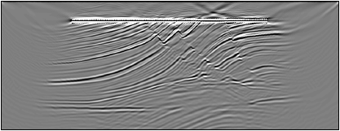
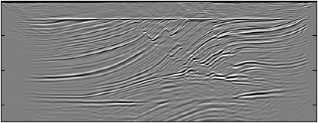
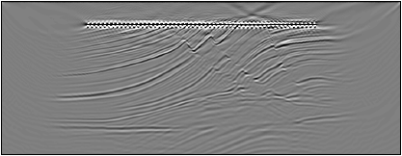
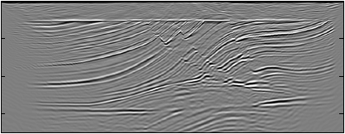
Image of Primary Vs Multiples
3.5 Z (km) 0
Primary Image with R.I. 50 m
Multiples Image with R.I. 50 m
3.5 Z (km) 0
Primary Image with R.I. 100 m
Multiples Image with R.I. 100 m
0 X (km) 9
0 X (km) 9

Slide 20
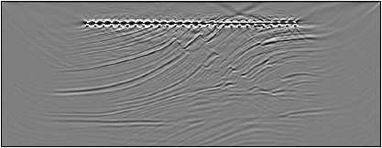
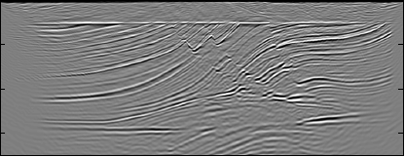
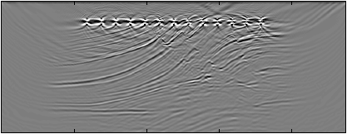
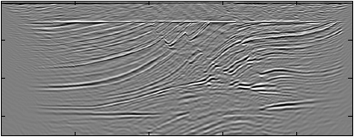
Image of Primary Vs Multiples
3.5 Z (km) 0
Primary Image with R.I. 200 m
Multiples Image with R.I. 200 m
3.5 Z (km) 0
Primary Image with R.I. 400 m
Multiples Image with R.I. 400 m
0 X (km) 9
0 X (km) 9

Slide 21
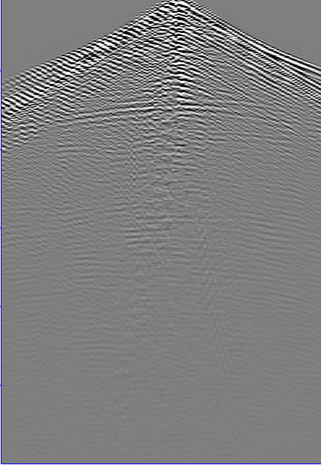
Field Data
Common Receiver Gather
12 T (s) 0
Receivers: 9
Interval: 400m
Sources: 124
Interval: 75m
Water Depth: 40m
0 X (km) 9

Slide 22
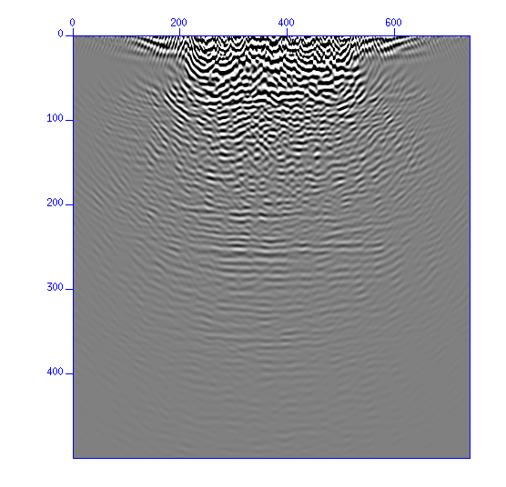
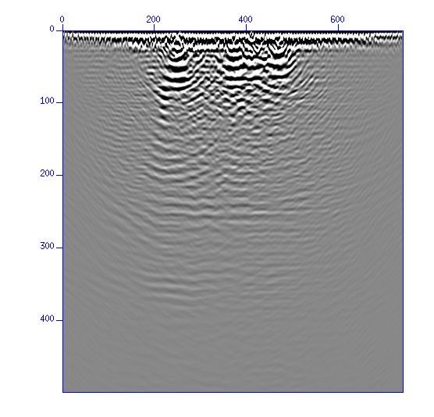
Field Data
6 Z (km) 0
Image of Primary
Image of Multiples
best
0 X (km) 9
0 X (km) 9

Slide 23
Outline
Motivation
Wider illumination, no footprint artifacts
Theory
Reverse time migration of multiples
Numerical Example
Test on Marmousi model and field data
Conclusions

Slide 24
Conclusions
Wider illumination
No footprint artifact
FWI of OBS data

Slide 25
Thank you!

